Slide 1
SOLAI PAINTS
SALES AND PRODUCTION TREND ANALYSIS

Slide 2
KEY INSIGHTS & SOLUTIONS: 2023-2025 DATA
OBJECTIVES:
Brief overview of current Trend i.e. How is the current year looking like?
Identify Sales Trend i.e. When did sales start going down?When are the lowest sales months and/ years?
Identify production Trend i.e. When did production start going down.
Identify contributing factors to the trends i.e. What could be the problem?
Identify solutions to these contributing factors i.e. What can we do to solve these problems?

Slide 3
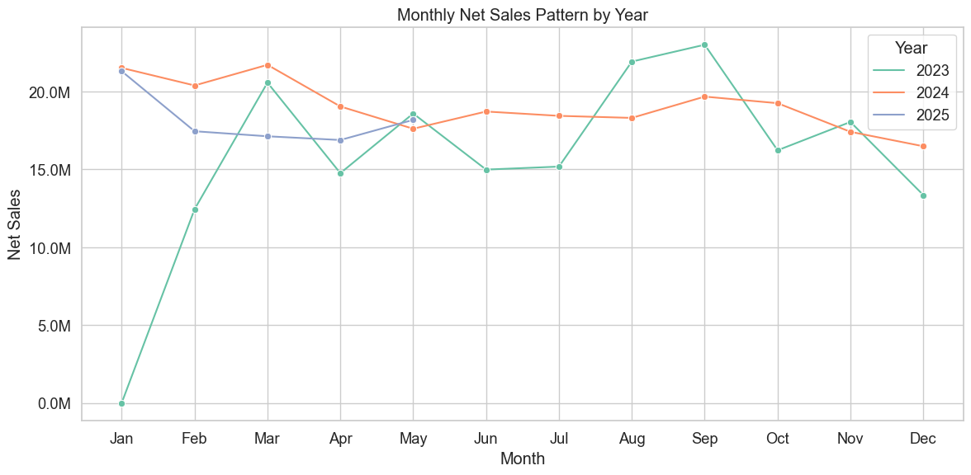
CURRENT YEAR TREND(2025)

Slide 4
CURRENT YEAR TREND(2025)
January 2025 started strong (~21.3 M), but there’s a clear month-on-month decline to March. The sharpest drop happened between January and February, while March remained relatively stable compared to February.
Q2 data shows slight recovery, with May 2025 outperforming previous years.
Watch Q2 and Q3 closely- if sales rebound, it could mean seasonal shifts or delayed demand.

Slide 5
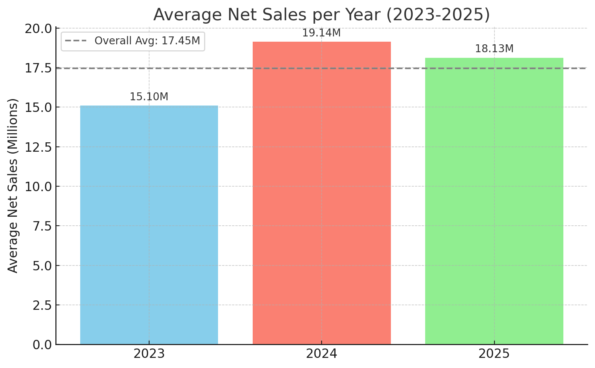
SALES YEARLY TREND

Slide 6
SALES YEARLY TREND INSIGHTS
Plot 1: Average Net Sales (2023–2025)
Each bar represents the average monthly net sales for the year.
The gray dashed line shows the overall 3-year average (~17.45 million).
2025 uses only data from Jan–May, as it's incomplete.
Insights:
2024 had the highest average net sales (~19.14M).
2023 had the lowest (~15.10M), likely due to lower early-year figures.
2025 is currently strong (~18.13M), above the 3-year average.

Slide 7
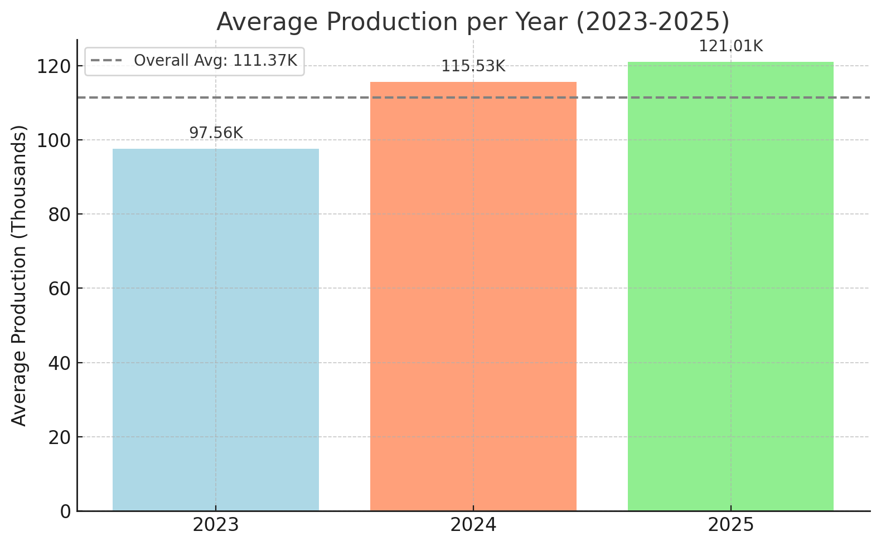
PRODUCTION YEARLY TREND

Slide 8
PRODUCTION YEARLY TREND INSIGHTS
Plot 2: Average Production Levels (2023–2025)
Bars show average monthly production levels in thousands of units.
2025 average is based on data from Jan–May.
The overall average across the three years is ~111.37K.
Insights:
Production has been increasing yearly.
2025 is currently leading with ~121.01K average monthly units.
2023 had the lowest at ~97.56K, reflecting possibly lower capacity or scale.

Slide 9
SALES TREND: When did sales start going down?

Slide 10
SALES TREND: When did sales go down?
2023 Sales Trend
Jan: no sales recorded
Feb–Mar: Strong recovery (12.4M → 20.5M)
Apr–Jun: Fluctuations but relatively strong (14.7M → 18.5M → 14.9M)
Jul–Sep: Upward climb with peak in September (~23M)
Oct–Nov: Slight drop from peak (~16.2M, then 18M)
Dec: Falls to ~13.3M
Key Change Point: Sales began falling in Q4 — particularly from October to December 2023

Slide 11
SALES TREND: When did sales go down?
2024 Sales Trend
Jan–Mar: Strong and stable (21.5M → 20.3M → 21.7M)
Apr–Jun: Flat but healthy (19M → 17.6M → 18.7M)
Jul–Sep: Consistent and high (18.4M → 18.3M → 19.7M)
Oct–Dec: Clear downtrend (19.2M → 17.4M → 16.4M)
Key Change Point: Sales started declining in Q4 again, just like 2023 — October onward

Slide 12
SALES TREND: When did sales go down?
2025 Sales Trend (Partial Year)
Jan: 21.3M — strong start
Feb: 17.4M — steep drop
Mar: 17.1M — continues decline but slows
Apr–May: Gradual recovery (16.8M → 18.1M)
Key Change Point: 2025’s decline began early — from January to March, followed by a slow recovery
Final Insight – When Did Sales Start Going Down?
In 2023, sales dropped in October, with lowest point in December
In 2024, a similar pattern — steady sales until Q4, then decline
In 2025, the drop came early (Q1), unlike previous years

Slide 13
SALES TREND: When are the lowest sales months and/ years?
Lowest Month Overall: January 2023 had zero sales
Other Lows:
December 2024 (~16.5M)
March 2025 (~17.1M) marks a continued but slowing decline from January.
Worst : Q4 2024; Shows continuous decline to December.

Slide 14
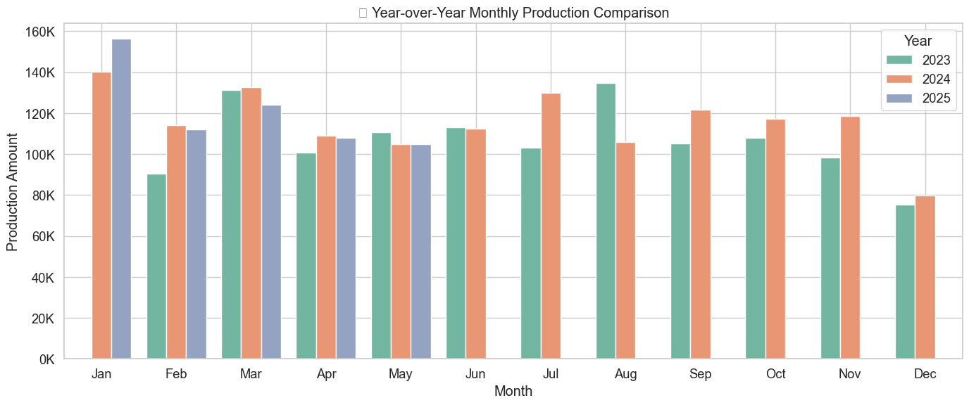
PRODUCTION TREND: When did production go down?

Slide 15
PRODUCTION TREND: When did production go down?
2023 Production
Starts in Feb (~90K) and rises to ~131K in Mar
Peaks in Aug (~135K) — highest point of the year
Declines steadily from Sep (~105K) to Dec (~75K)
Insight:
Production peaked in August, then dropped from September to year-end, hitting its lowest in December

Slide 16
PRODUCTION TREND: When did production go down?
2024 Production
Strong Q1: Feb–Mar (~114K to ~133K)
Peaks again in July (~130K) and stays high through Sep (~122K)
Starts falling in Oct (~117K) and plunges to Dec (~80K)
Insight:
Similar to 2023 — strong mid-year, but production dips sharply in Q4, ending with a steep drop in December

Slide 17
PRODUCTION TREND: When did production go down?
2025 Production (Feb–May only)
Starts strong in Feb (~112K) and Mar (~124K)
Declines in Apr (~108K) and May (~105K)
Insight:
Unlike previous years, 2025 shows an early Q1 decline, with production falling steadily from March

Slide 18
What Could be the Problem(s)?
Consistent Q4 Drop in Both Sales & Production
Both sales and production fall sharply in December every year (2023 & 2024).
December is the lowest production month, and also among the lowest sales months.
This suggests:
End-of-year shutdowns, reduced capacity, or poor inventory planning.
Missed holiday demand ; no ramp-up ahead of consumer spikes.

Slide 19
What Could be the Problem(s)?
2. Early-Year Volatility (Especially 2025)
In 2025, both sales and production decline in Q1, unlike previous years.
Possible causes:
Excess inventory from previous year
Demand uncertainty or delayed procurement
Strategic misalignment between production planning and market conditions

Slide 20
What Could be the Problem(s)?
3. Mismatch Between Production and Demand
Production often peaks after or during flat sales, e.g., mid-2023 and 2024.
Overproduction → inventory buildup → wasted capacity or write-offs.

Slide 21
What Could be the Problem(s)?
Poor Responsiveness to Seasonal Trends
There’s no clear tactical ramp-up before known high-sales months like Q3.
Similarly, no proactive cutback ahead of Q4 decline.

Slide 22
Proposed Solutions
1. Improve Demand Forecasting
Use historical sales + production patterns (especially quarterly) to forecast accurately.
Predict Q4 dips and Q3 peaks, and align production accordingly.
2. Align Production Cycles With Sales Cycles
Avoid overproduction in flat or declining months.
Scale up production before Q3, and scale down before December to reduce end-year losses.

Slide 23
Proposed Solutions

